Slide 1
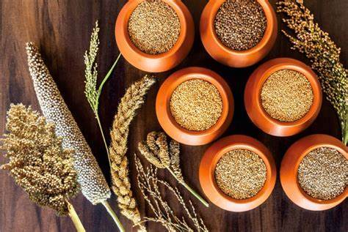


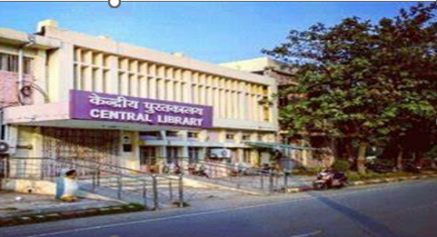
ONE DAY WORKSHOP
On
INTRODUCTION OF MILLETS IN DAY-TO-DAY LIFE FOR A HEALTHY WELL BEING
(30 November, 2022)
Organized by
Central library
Motilal Nehru National Institute of Technology Allahabad
Prayagraj, Uttar Pradesh – 211004 (India)
www.mnnit.ac.in

Slide 2
ABOUT THE INSTITUTE
Motilal Nehru National Institute of Technology (MNNIT) Allahabad, Prayagraj (MNNIT Allahabad) is an institute with total commitment to quality and excellence in academic pursuits. It was established as one of the seventeen Regional Engineering Colleges of India in the year 1961 as a joint enterprise of Government of India and Government of Uttar Pradesh, and was an associated college of University of Allahabad, which is the third oldest university in India. With more than 50 years of experience and achievements in the field of technical education, having traversed a long way, on June 26, 2002 MNREC was transformed into National Institute of Technology fully funded by Government of India. With the enactment of National Institutes of Technology Act-2007, the Institute has been granted the status of institution of national importance w.e.f. 15.08.2007.
ABOUT THE CENTRAL LIBRARY
The Library is sanctum sanatorium in the temple of learning. It is the heart of teaching and research. The Central library has 1,22,670 Collection of books and bound periodicals. It also subscribes 14526 International e-Journals, 7998 e-Standards and 29508 IEEE e-Conference Proceedings. In order to facilitate all the readers in selecting the reading materials of their choice, the access to stacks is open to its members. Keeping the library on modern techniques, the reading materials has been classified and catalogued as Dewey Decimal Classification and Anglo- American Cataloguing Rules-II.
The entire library is now integrated with the RFID enabled Gate Security System with the help of two-pedestal antenna. It works as nerve centre of the institution by keeping the knowledge of students and faculty members update. Information data bank is constantly updated and facilities are added. The library tries to provide best possible service to the academic community within its limited space available. The functionaries of Central Library are guided by the setup of LLRC and Working Group.

Slide 3
ABOUT THE ONE DAY WORKSHOP | TOPICS TO BE COVERED
Considering the current scenario of food crisis and malnutrition this workshop is being held to spread awareness about the magical grain millets. Millets are a group of cereal grains that belong to the Poaceae family, commonly known as the grass family. It is widely consumed in developing countries throughout Africa and Asia. While it may look like a seed, millet’s nutritional profile is similar to that of sorghum and other cereals. Millets have gained popularity in the West because they are gluten-free and boasts high protein, fiber, and antioxidant contents. The workshop has been planned to provide the participants an overview on the benefits of consuming millets, its nutritional content and how millet can help deal with food crisis in various part of world. | Nutritive value of millet Millet as miracle food Millets: A solution to global food security problem Learning and E-resource Management Quiz Poster presentation Dish display (star ingredient: millet) Offline Venue: SEMINAR HALL, CENTRAL LIBRARY, MNNITA
ACTIVITIES
MODE OF CONDUCT

Slide 4
TARGET AUDIENCE
This course is designed for participants from various backgrounds including all the faculties and students from various institutes. After registration the candidate have to provide their consent for participation to the coordinator by visiting the link or scan the QR code. (google form) Interested candidate can register by visiting the link https://docs.google.com/forms/d/e/1FAIpQLScBgUXmyItOrrKCurIm5DwNK874hkx8HPqChCK62qOCSwgkdA/viewform?usp=sf_link
REGISTRATION
The registration fees of all the participants is as follow: For students : Rs. 350 (+18% GST) For faculty : Rs. 500 (+18% GST) ACCOUNT HOLDER NAME: NON FORMAL CONTINUING OF EDU ACCOUNT NUMBER: 10424975574 IFSC CODE: SBIN0002580 BRANCH: SBI, MNNIT Allahabad
SCHEDULE
09.00 AM – 09.30 AM | Registration & Coffee
09.30 AM – 09.45 AM | Inaugural ceremony
9.45 AM – 10.45 AM | Session 1 : Millets: The nutri-cereal
11.00 AM – 11.15 AM | Dish display (star ingredient: Millets)
11.30 AM – 12.30 PM | Session 2 : Millets: A solution to global food security problem
12.30 PM – 13.15 PM | Lunch
13.15 PM – 14.15 PM | Session 3 : Eat millets, pay less and stay healthier
14.15 PM – 14.45 PM | Break
14.45 PM – 16.00 PM 15.30 PM – 16.30 PM | Session 4 : Quizzes & Posters Session 4 : Learning and E-resource management
16.30 PM – 17.00 PM | Laboratory demonstration (DPPH assay/ flavonoid determination via gas chromatography method)
17.00 PM – 17.30 PM | Prize distribution and Vote of Thanks
CONSENT TO PARTICIPATE

Slide 5
Open access
Participants of quiz and poster presentation will be provided with goodies
The certificate will be awarded to all the participants.
OTHER RELEVANT INFORMATION FOR PARTICIPANTS
PATRON
Prof. Rama Shanker Verma Director Motilal Nehru National Institute of Technology Allahabad Prayagraj, Uttar Pradesh – 211004 (India)
Programme Coordinator | Co-coordinator
Prof. Anjana Pandey Chairperson Library and Learning Resource Committee Motilal Nehru National Institute of Technology (MNNIT) Allahabad, Prayagraj Email: anjanap@mnnit.ac.in Contact No: 9452690849 | Dr. Anoj Kumar Associate professor Department of Computer Science MNNITA Email: anojk@mnnit.ac.in Mr. Ritesh Kumar Sahu Dy. Librarian, Central Library MNNITA Email: ritesh@mnnit.ac.in
Local organising committee
Dr. Sonam Agrawal
Sri Arvind Kant Singh
Vandita
Nahid Rehman
Divya
Shraddha Shukla
Ashutosh Gupta
Treasurer

